Slide 1
EmployeeTrackingSystem
Core JAVA PROJECT

Slide 2
ABSTRACT
The Employee tracking application is prepared as a console-based core java project. The system tracks the performance of all registered employees in an organisation, involved in different projects. The detailed address of the employees is stored in a different entity and may be referred to when tracking of employees is necessary or their proximity to each other and involvement in different projects may need to be conveniently assigned.
The Manager entity of the system benefits the managerial staff to track the employees efficiently to know their allotment, department, progress, and scheduling data.
This system requires no web server and may be executed from a digital device within the onsite premises of an organisation which can effectively use it to understand the performance of its employees.
The system helps in
Division of labour
Understanding effectiveness of each employee
Understanding employee potential
Project constraints
Effective scheduling
Effective running of organisational framework
Less cost involvement
Tracking employee details

Slide 3
INTRODUCTION
1.1 Project Objectives
Admin Objectives
It is an admin dependent system which has no user functionality. The salient features of the Employee Tracking System are:
It is easy to execute the java classes which is possible just with the presence of jdk .
It is an instant system of entry and checking entries of employee details, which involve less complication and hassle.
It does not involve a web server at present as it does not give a facility of browser execution or deployment as such.
It does not involve a database. It therefore hardly requires storage space.
However it facilitates updation as it is prepared in an IDE and can be easily converted into a web based project using hibernate + MySQL or any other database in future.
1.2. Constraints
A few functionalities could not be implemented.
The system suffers from the drawback of not being able to function at times due to session creation error for the application.
The employer or the manager constructor which is created as a inherited class from the employee class, has no existence if employees do not exist. So, Manager class bears a IS-A relationship with the Employee class. The Manager class is created as the child class of Employee. Employee is the parent class of the manager class.
Address bears a HAS-A relation with Employee. It is an Association of Composition type, with the Employee class. Mysql was not used as JDBC was not to be used in this project.
1.3. Risks
Document specific risks that have been identified or that should be considered.
The authenticity of users is not determined.
The Console based project is not equipped to provide detailed view of employees. The database is not used which makes calling of employees view on the basis of employee id not possible.
The project may suffer from updation and deletion anomalies for which the development need to be converted to different classes for insertion or deletion.
1.4. Out of Scope
The project is developed in the local system and the code in github repository.
The project is not hosted in any cloud platform and is still not available in on internet.
Setting of parameters in database for further use is not possible.
Employee authentication or the authentication of user of the application is out of scope.

Slide 4
2. TECHNICAL SPECIFICATIONS
It includes the hardware software and other technical requirements of the system. Any platform and machine with an installed jdk can effectively run the application. As the project is developed in java it is:
Portable
Simple to understand and implement
Any database can be used for stating minimum employee details
Minimum storage and any RAM that effectively runs a java application can be used.
The application uses the System Library which may vary from machine to machine.
The application is developed in Eclipse IDE. It may be opened in any IDE or it may even run in command prompt.
2.1. Hardware Requirements
Hard disk : 256 MB required
Main memory: 512 MB
Processor: Intel Pentium microprocessor with RYZEN
Keyboard: Standard
Monitor: 600x800 Resolution or above
Mouse: Scroll
2.2. Software Requirements
Tools and platforms used
֎ Operating System: Windows11
֎ Platform: :ECLIPSE IDE [2022-09]
֎ Language: CORE JAVA
Software interfaces
Application: Eclipse IDE [2022-09]
Jdk : 8
Additional API: MS OFFICE
No DATABASE used and no schema needed to be developed. Technological Specification was not a matter of concern for the project.

Slide 5
3. SOFTWARE DEVELOPMENT METHODOLOGY
3.1. SOFTWARE LIFECYCLE MODEL
The software to be developed depends on the series of identifiable stages that would eventually lead to the product. The diagrammatic representation would follow in building the logical framework. It would be based on the requirements analysis and the design phase. The proposed software is planned after the requirements analysis and therefore may be developed by means of the iterative waterfall model. In order to give it a stage to analyse the effects of the prior stage, the iterative approach has been followed.
REQUIREMENTS ANALYSIS
SYSTEM ANALYSIS
SOFTWARE DESIGN
CODING
TESTING
DEPLOYMENT
MAINTENANCE

Slide 6
3.2. REQUIREMENTS ANALYSIS
3.2.1. PROBLEM SPECIFICATION
The system to be developed is based on core java as a console-based project. The system is developed to track which employees are involved in which project and their details.
Employees and their details are inserted in the system.
Employee details, as Address may be updated in the system.
Employees may be removed from a project.
A Manager view is created in the manager class.
No database and no connector are involved. Employees are stored in employee array.
Linked hash map is used for a quick view of empid and employee_ name.
The code is portable and easily maintained. It may well be enhanced and modified.
3.2.2. FEASIBILITY STUDY: The development of any Software depends on the fact that whether it is feasible for development or not. This study is done for the various factors which might affect the software development, deployment and maintenance. It is also targeted for Customer Relationship Management in future.
3.2.2.1. TECHNICAL FEASIBILITY:
The software is a simple console-based application. It is purely coded in java.
The Software is to be managed and maintained after deployment
on an iterative basis,

Slide 7
3.2.2.2. SOCIAL FEASIBILITY: This software is socially feasible as a fast checking of projects and employees involved in the projects. Visibility to employee details especially with their address and contact details becomes a necessity.
Creation of a manager view is of importance to checking employee records. The present system is a handy method of instant updating and checking.
3.2.2.3. ECONOMIC FEASIBILITY: The system does not need any installations. It does not involve a database or a web server. As it is coded in java it can be run on cmd if an IDE is not available. It implements the java features and the code being portable is a handy method.
3.2.2.4. LEGAL FEASIBILITY:
The Legal feasibility of the system development is based on whether the employee details checked are authentic or not. As employees are generally distributed and assigned projects according to their domain and specific study fields, they might need to share details with one another. This problem makes it necessary to understand the Residential Address authenticity of the employees. This problem may be solved in future by employing database storage facilities with accepting files for address proof.
The feasibility study conducted on the system has helped its development and further maintenance

Slide 8
3.3. SOFTWARE REQUIREMENTS SPECIFICATION
3.3.1. This part of the document provides a comprehensive description of the Software to be developed by the system. The different subsections provide the information of the Software and hardware to be used by the system.
4.3.1. PURPOSE: The SRS aims at the development of the system requirements. The employee tracking system is a must have for all concerned organizations.
The vision of the system is a unified platform of Employee details to track their whereabouts and their involvement in projects.
The mission is to strive towards the goal with a reduction of insertion and deletion anomalies to have a better track of every employed person involved in a company.
SCOPE: The system may be used by an individual data entry operator of an organisation with very few instructions to follow.
The system runs offline and requires no web server installation.
It gives instant entry and check facilities with less typing and entry hassles.
The portable system created in pure core java, runs at present on the simple build level without any database and has a lot of maintenance scope and can be easily connected in time with any database just by integrating with Hibernate or by usage of JDBC.
. ABBREVIATIONS:
Table : 5.1.
Specification: IEEE STD 830-1993
SRS | Software Requirements Specification
DFD | Data Flow Diagram
ERD | Entity Relationship Diagram
ID | Identification Definition
jdk | Java development Kit
jre | Java runtime environment
IDE | Integrated Development Environment

Slide 9
3.3.2. FUNCTIONAL REQUIREMENTS:
This gives specific details about how the system is supposed to behave after execution in the virtual machine. It also gives what inputs are provided to which process and what is the expected output of each. It also denotes how the system might behave and what are the specific data manipulations and calculations.
3.3.2.1. Employee insertion [address class gets executed first]:
Employee address is given as an input
Input: Address address (), zip_ code, street, city, state, country
Output: address input success
3.3.2.2. Employee class insertion:
Input: empid, employee _ name, employee _ email, employee_ phone, project_ name
Output: employee class inserted successfully
3.3.2.3. Manager class insertion:
Input: department_ name, no _ individuals _ reporting, timesheet _ begin , timesheet _end,
Employee object
Output: status, save()
3.3.2.4. Employee selection:
Input: empid
Output: employee_ name, employee_ email, employee_ contact, project_ name, address, department _ name,
3.3.2.5. Employee updation(address):
Input: empid, Address new _address
Output: save(), status
3.3.2.6. Employee deletion :
Input empid
Output: status , save()

Slide 10
NON-FUNCTIONAL REQUIREMENTS: These are directly related to the functioning of the system. The main constraints of the system are
Hardware interface:
Screen Resolution of 600x800.
Mouse for scroll
PC or Laptop
Software Interfaces:
֎ Eclipse IDE for developing java Code
֎ Windows 11 OS
jre used: 1.8
Communications Interfaces: None
4.1. 3..6. Performance requirements: java classes
Software System attributes:
Maintainability: This is achieved by updating the system on the basis of present requirements and implementation of Client demand techniques, as gathered from feedback of users.
Portability: This feature is achieved by using JAVA as a programming language. The OOPS feature helps the system to have a portable feature. It is therefore made to run on any
Operating System on any machine.

Slide 11
PROJECT PLANNING AND SCHEDULING
NAME OF PHASES SUB PHASES OR DESCRIPTION
Requirements analysis | Problem definition
 | Feasibility study
 | Software requirements analysis
Milestone : Successful SRS and Feasible System. Proceeding to Designing the System
System analysis | Project planning and Scheduling
 | System DFD
 | System Designing
 | Structure designing
Milestone :Completion of Design. Proceed to code the System
Coding | Coding with Comments
 | Code Efficiency
 | Error handling
Milestone : Error free Code
 | System Testing
 | Debugging
Milestone : Successful Testing
Implementation and Maintenance | improvement
Milestone : Successful Implementation

Slide 12
GANTT CHART: A horizontal bar chart which visually represents a project plan over time. The chart shows status of each task in the project.
TASK | START DATE | DAYS TO COMPLETE
Requirements analysis | 26th February, 2023 | 5 days
System Analysis | 3rd march | 1 day
Procrastination + trial with Hibernate Integration
System Design | 20th April | 1 day
Coding | 20th April-21st April | 2 days
Testing | 21st April | 1 day
Build | 21st April, 2023 | -
 | 26thFeb-3rd March,2023 | 3rd March-4thMarch | 4thMarch-20thApril | 20th April | 20th-21st April | 21st April
Tasks
Timings

Slide 13
SYSTEM ANALYSIS
4.1. DATA FLOW DIAGRAMS (DFD): Drawn to show the flow of data
between processes and entities of a System. It has no control flow. It is a mapping to demonstrate the flow of input and output from a process or entity.
CONTEXT LEVEL (ZERO LEVEL) DFD OF THE SYSTEM
zip_code,street,city,state,country
Employee
empid,employee_name,employee_email,employee_phone, Address
EmployeeTracking System
Manager
Address
empid, employee _ name , employee _ email , employee _ phone, Address , no _ individuals _ reporting ,timesheet _begin , timesheet _ end

Slide 14
Level-1 DFD
Manager
Employee insertion
6.1.2.
Employee
updation
Employee
Employee Selection
Employee deletion
Address

Slide 15
start
FLOW CHART
[Modular Representation To denote logical workflow
Insert Address as zip_code, street, city, state, country
setZipCode(),setStreet(),setCity(),setState(),setCountry()
Insert empid,employee_name,employee_email,employee_phone,
Address.address
setEmpid(),setEmployee_name(),setEmployee_email(),setEmployee_phone(),setAddress()
Do you want to view inserted Employee?
Insert department_name,no_individuals_reporting,timesheet_begin,timeSheet_end
viewManager()
setDepartment_name(),setNo_individuals_reporting(),setTimeSheet_begin(),setTimeSheet_end()
Stop

Slide 16
+empid: Integer
Employee
CLASS DIAGRAM: It is used as a mapping to design systems in Object Oriented languages. It is a static representation of each class, interface, association and constraint involved in designing the system.
+employee_name: String
+employee_email:String
1 n
+employee_phone: String
+project_name: String
+setEmpid(Integer empid)
+getEmpid()
+setEmployee_name(String employee_name)
+getEmployee_name()
+setEmployee_email(String employee_email)
+getEmployee_email()
+setEmployee_phone(String employee_phone)
+getEmployee_phone
+setAddress(Address address)+getAddress()
IS-A
HAS-A
1 1
-zip_code: Integer +department_name: String
-street: String +no_individuals_reporting:Integer
-city: String +timeSheet_begin:String
-state: String +timesheet_end:String
)ry()
Address Manager
-country: State
+setZip_code(Integer zip_code) +super()
+getZip_code() +setDepartment_name(String d)
+setStreet(String street) +getDepartment_name()
+getStreet() +setTimeSheet_begin(String tb)
+setCity(String city) +getTimeSheet_begin(+getCity()
+setTimeSheet_end(String te)
+setState(String state) +getTimeSheet_end()

Slide 17
ENTITY RELATIOSHIP DIACRAM
employee_ name
employee_ contact
employee _ email
Address address
empid
Employee
n 1
IS-A
HAS-A
no _ individuals_ reporting
zip _ code
Employee employee
department _ name
1 1
Address
timesheet _ begin
Manager
street
state
timesheet _ end
city
country

Slide 18
SYSTEM TESTING
Software testing is a crucial element and it represents the ultimate review of specification design & coding. There are two types of test approaches. They are-
Black Box Testig
White box testing
When computer software is considered, black-box testing alludes to tests that are conducted at the software interface. Black-box tests are used to demonstrate that software functions are operational, that input is properly accepted and output is correctly produced, and that the integrity of external information is maintained.
Other Testing methods are:
Unit testing:
Unit testing focuses verification effort on the smallest unit of software design—the software component or module. Here each module is tested individually and it was ensured that all the modules function as required.
Integrated testing:
Integration testing is a systematic technique for constructing the program structure while at the same time conducting tests to uncover errors associated with interfacing.
The objective is to take unit tested components and build a program structure
that has been dictated by design. Here the tested modules is combined together and were tested to work properly as a group of interactive modules. The main purpose of this testing is to check the interface between the modules.
Some test cases are supplied:

Slide 19
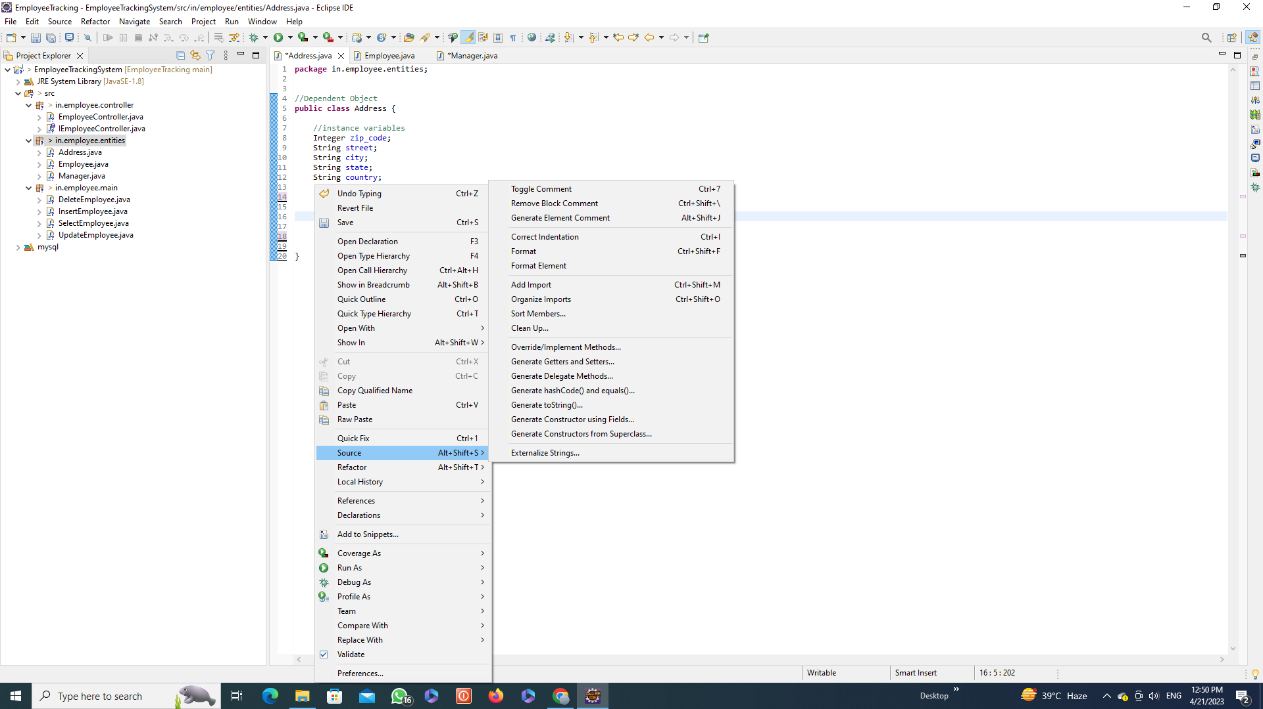

Slide 20
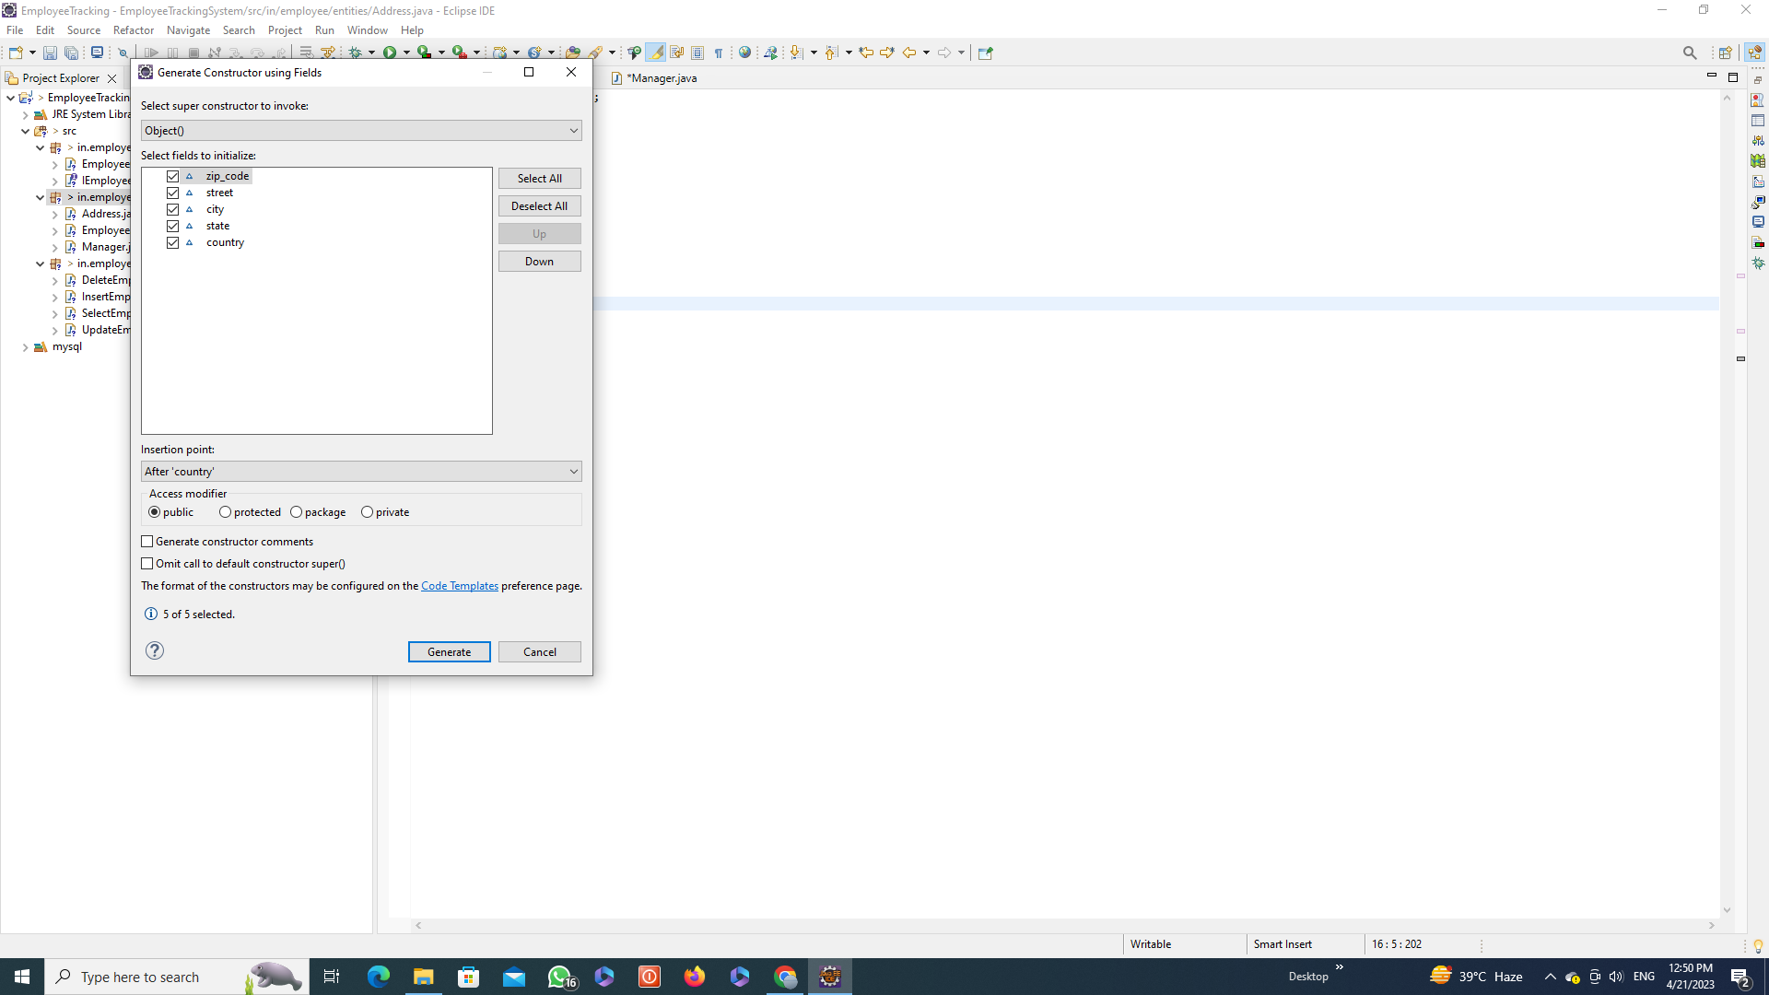

Slide 21
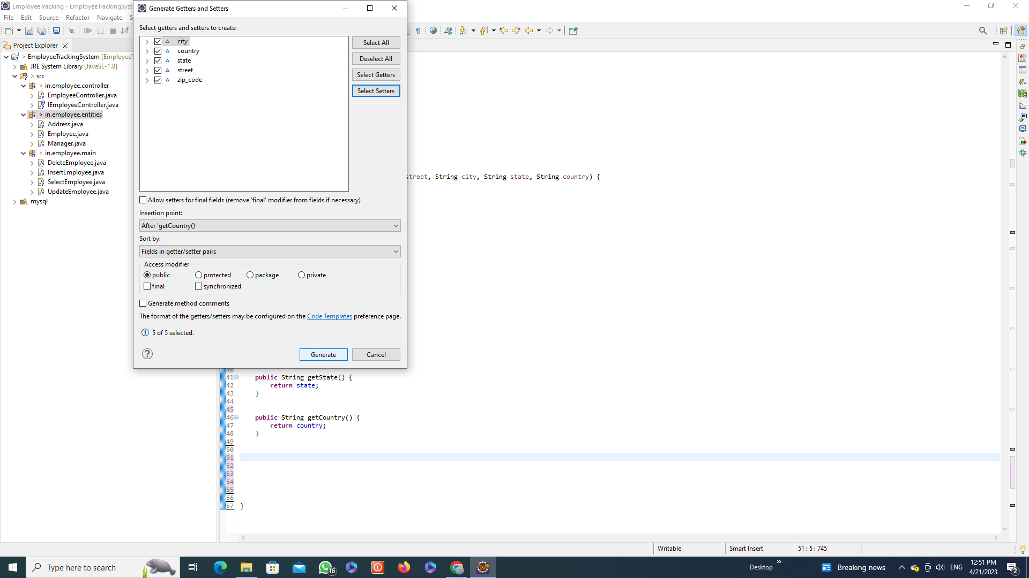

Slide 22
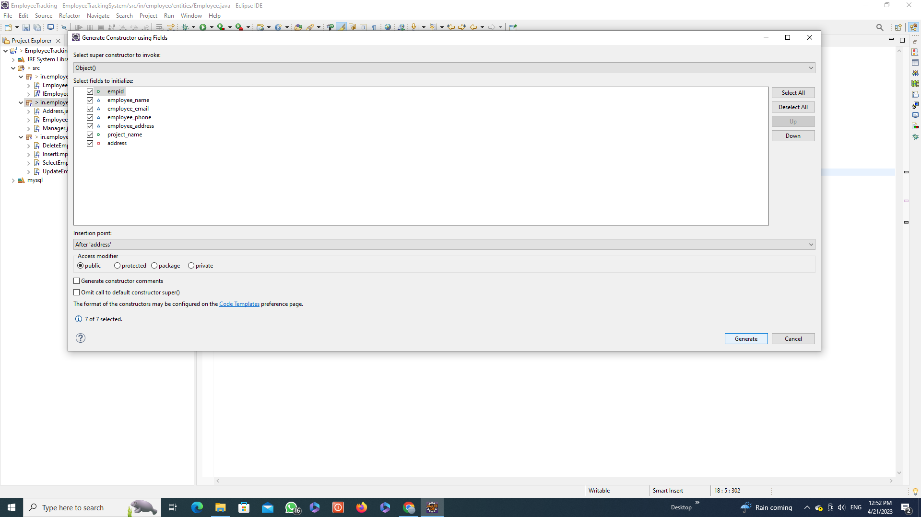

Slide 23
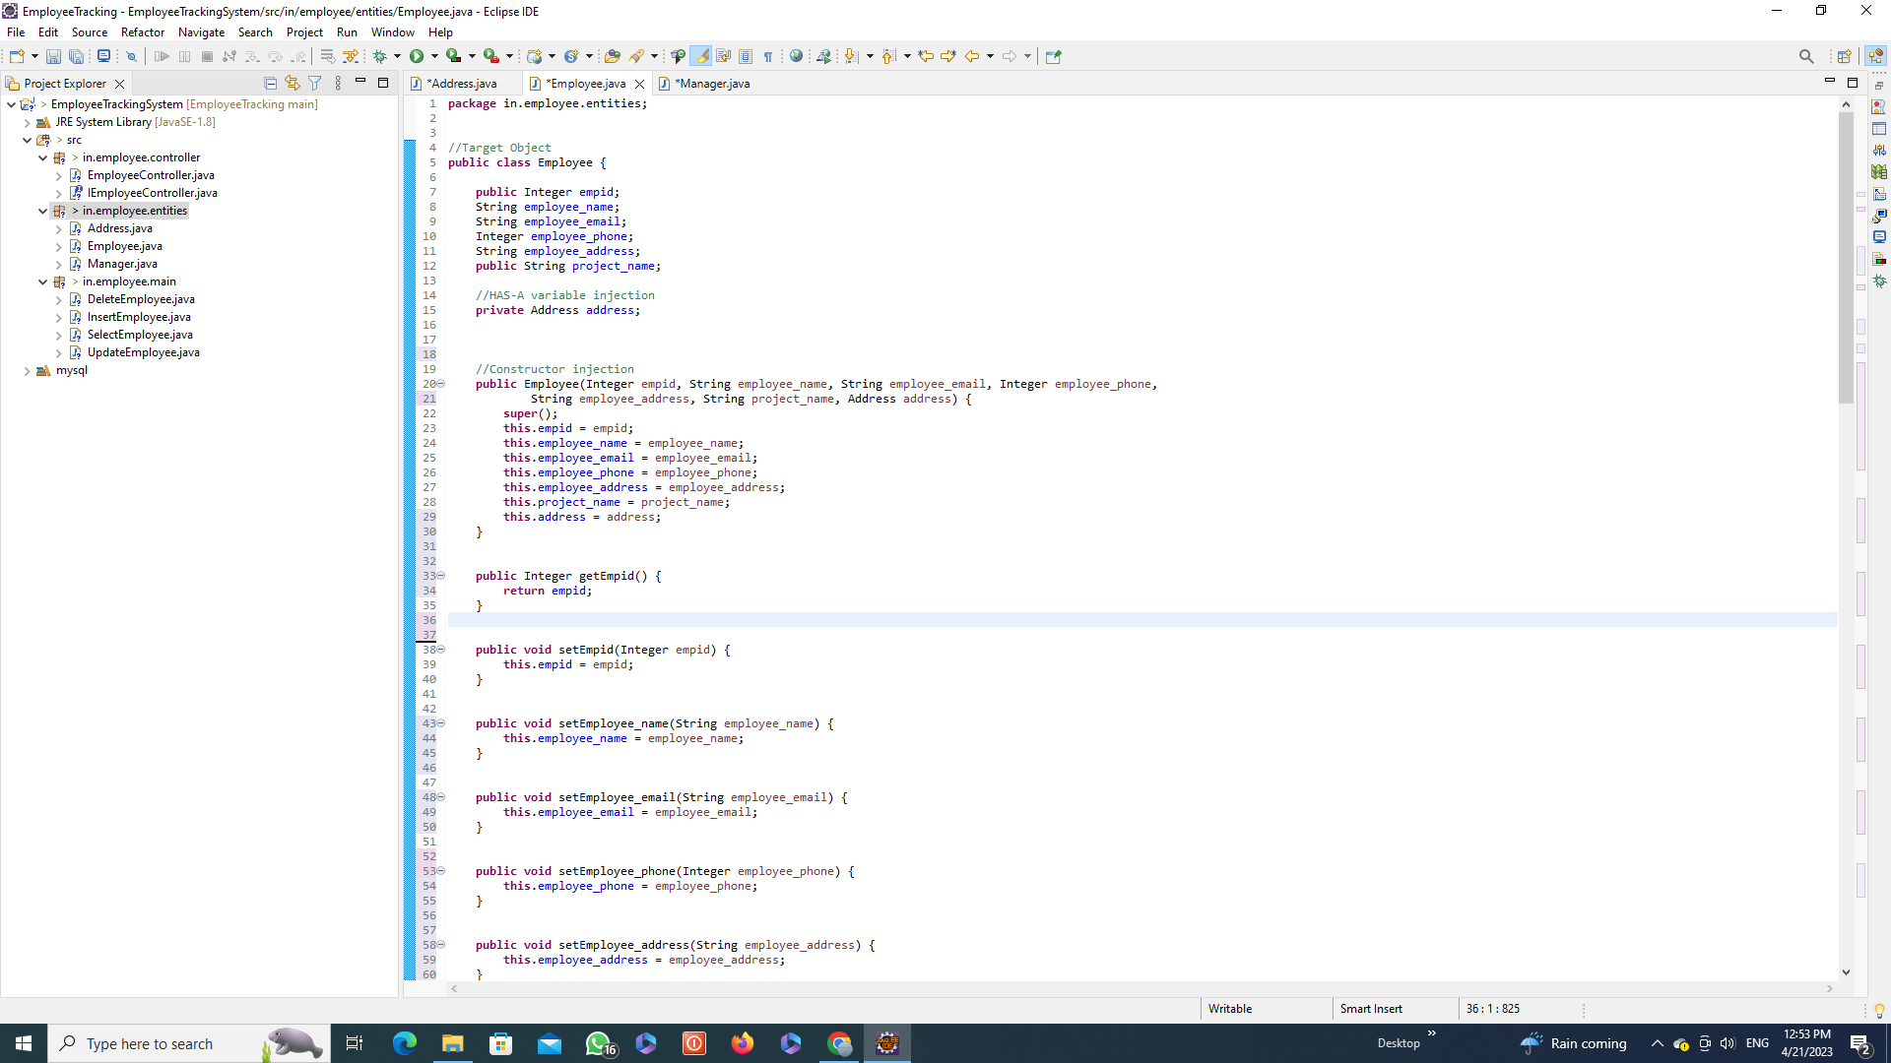

Slide 24
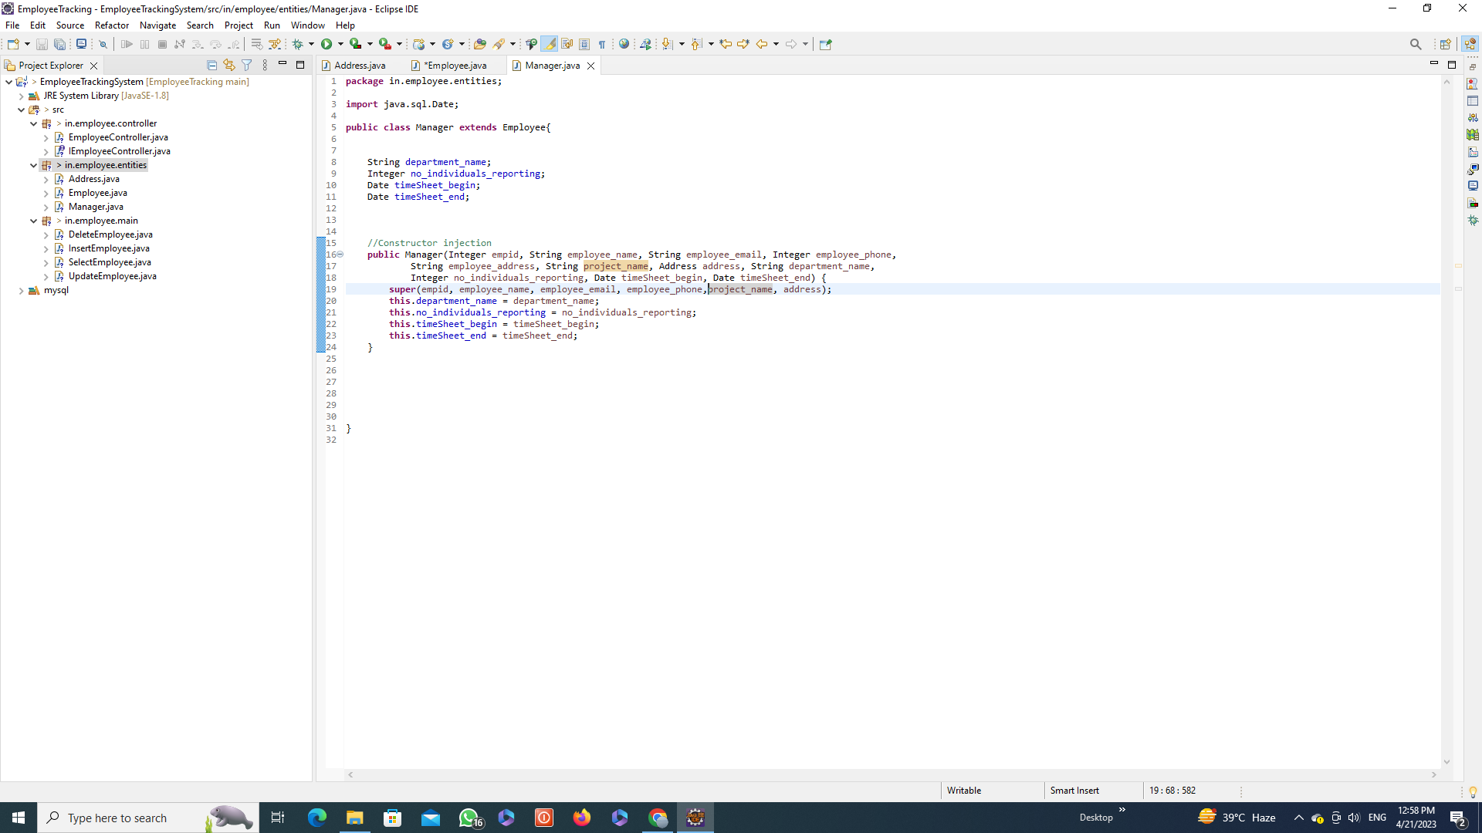

Slide 25
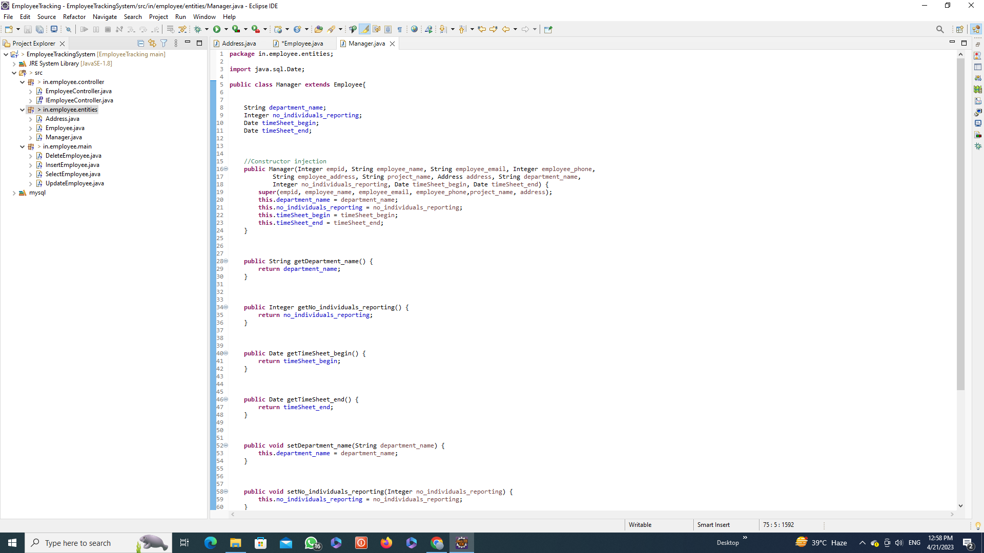

Slide 26
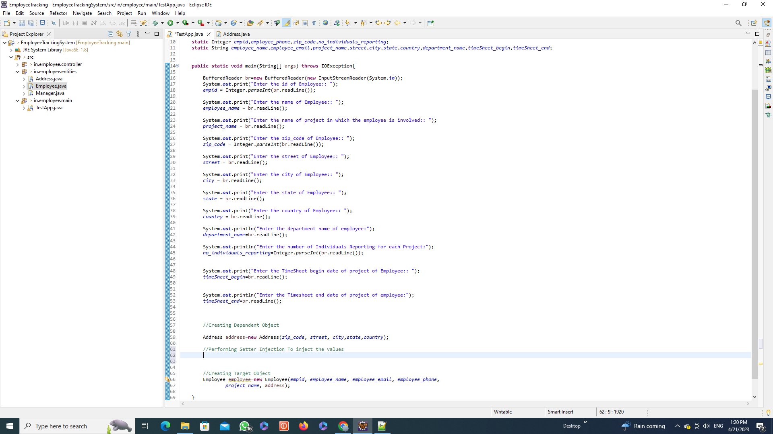

Slide 27
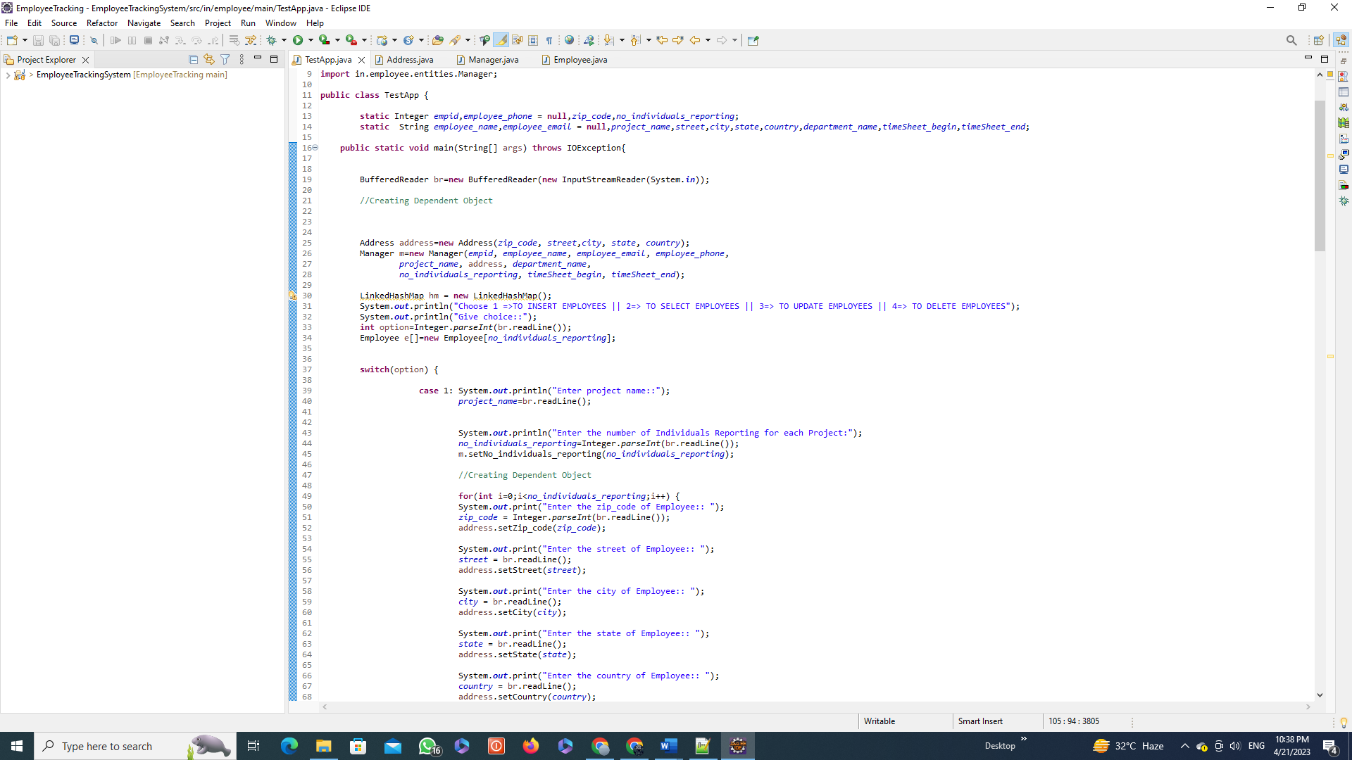

Slide 28
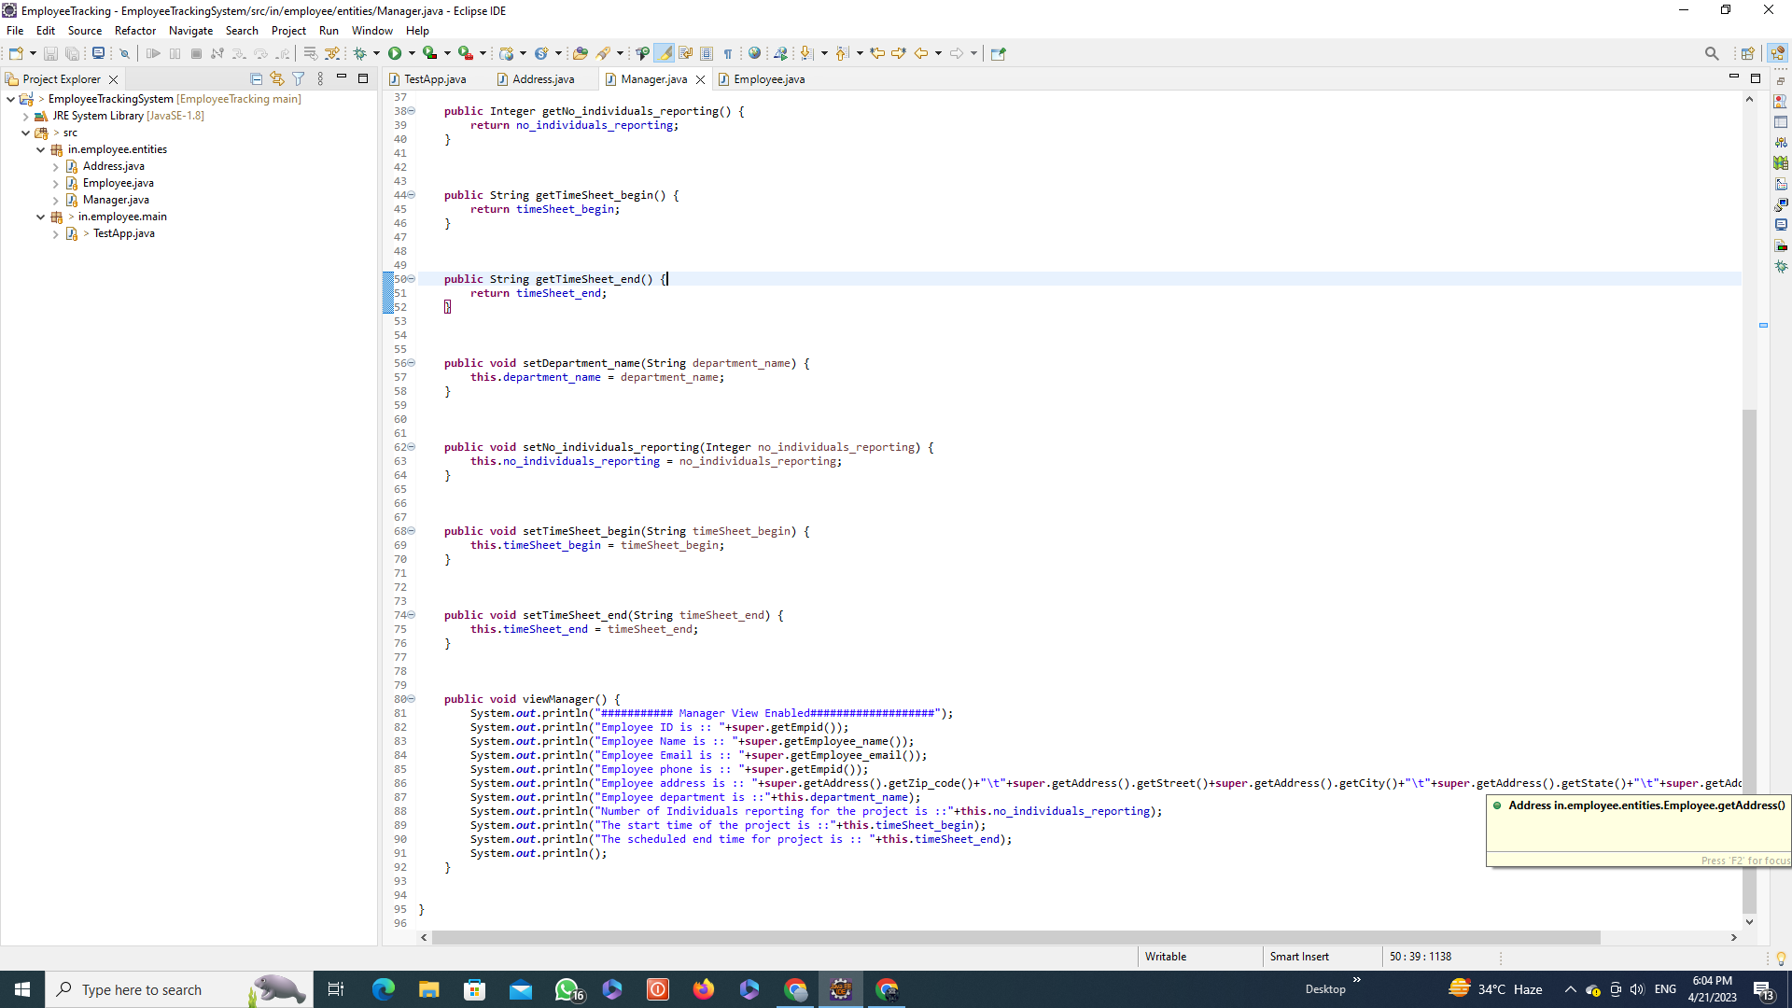

Slide 29
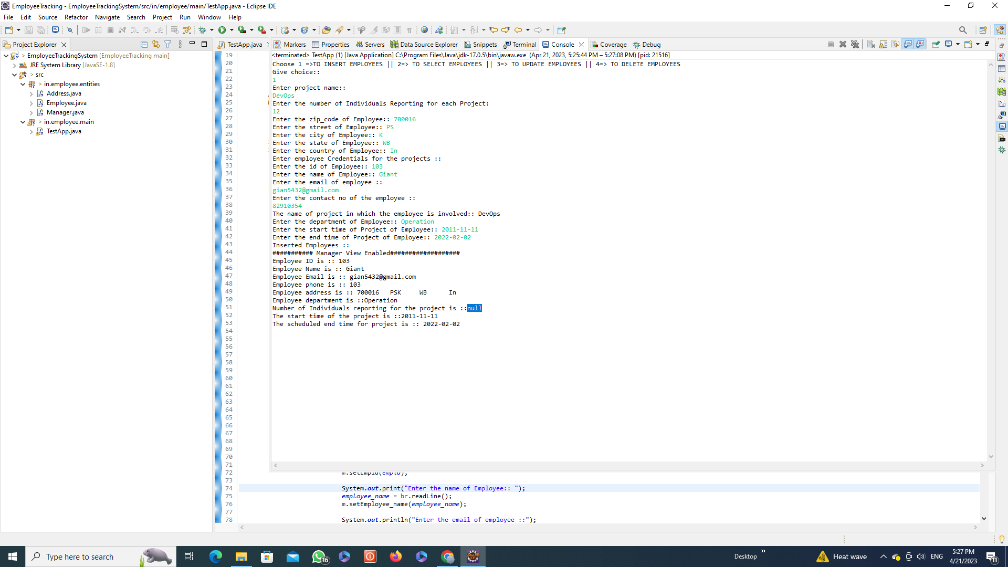

Slide 30
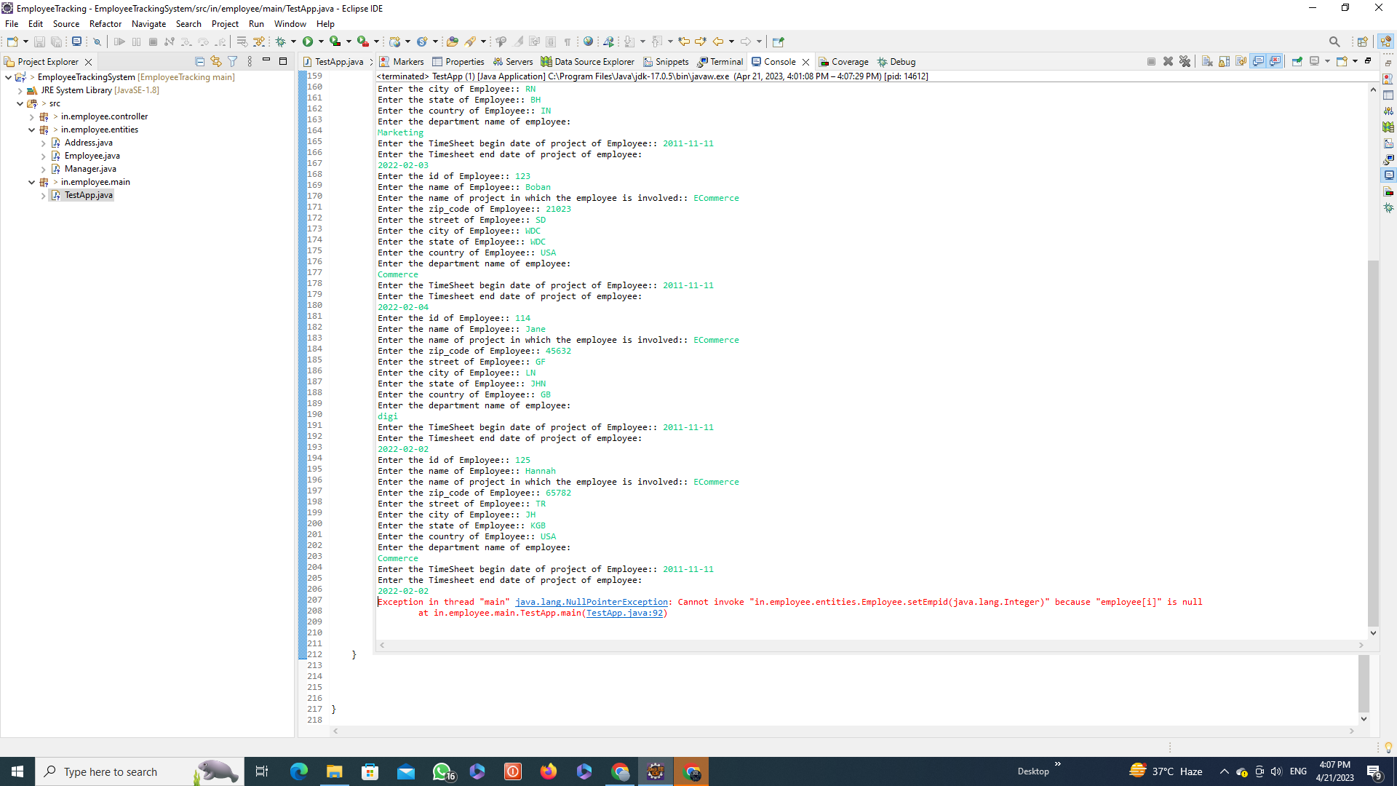

Slide 31
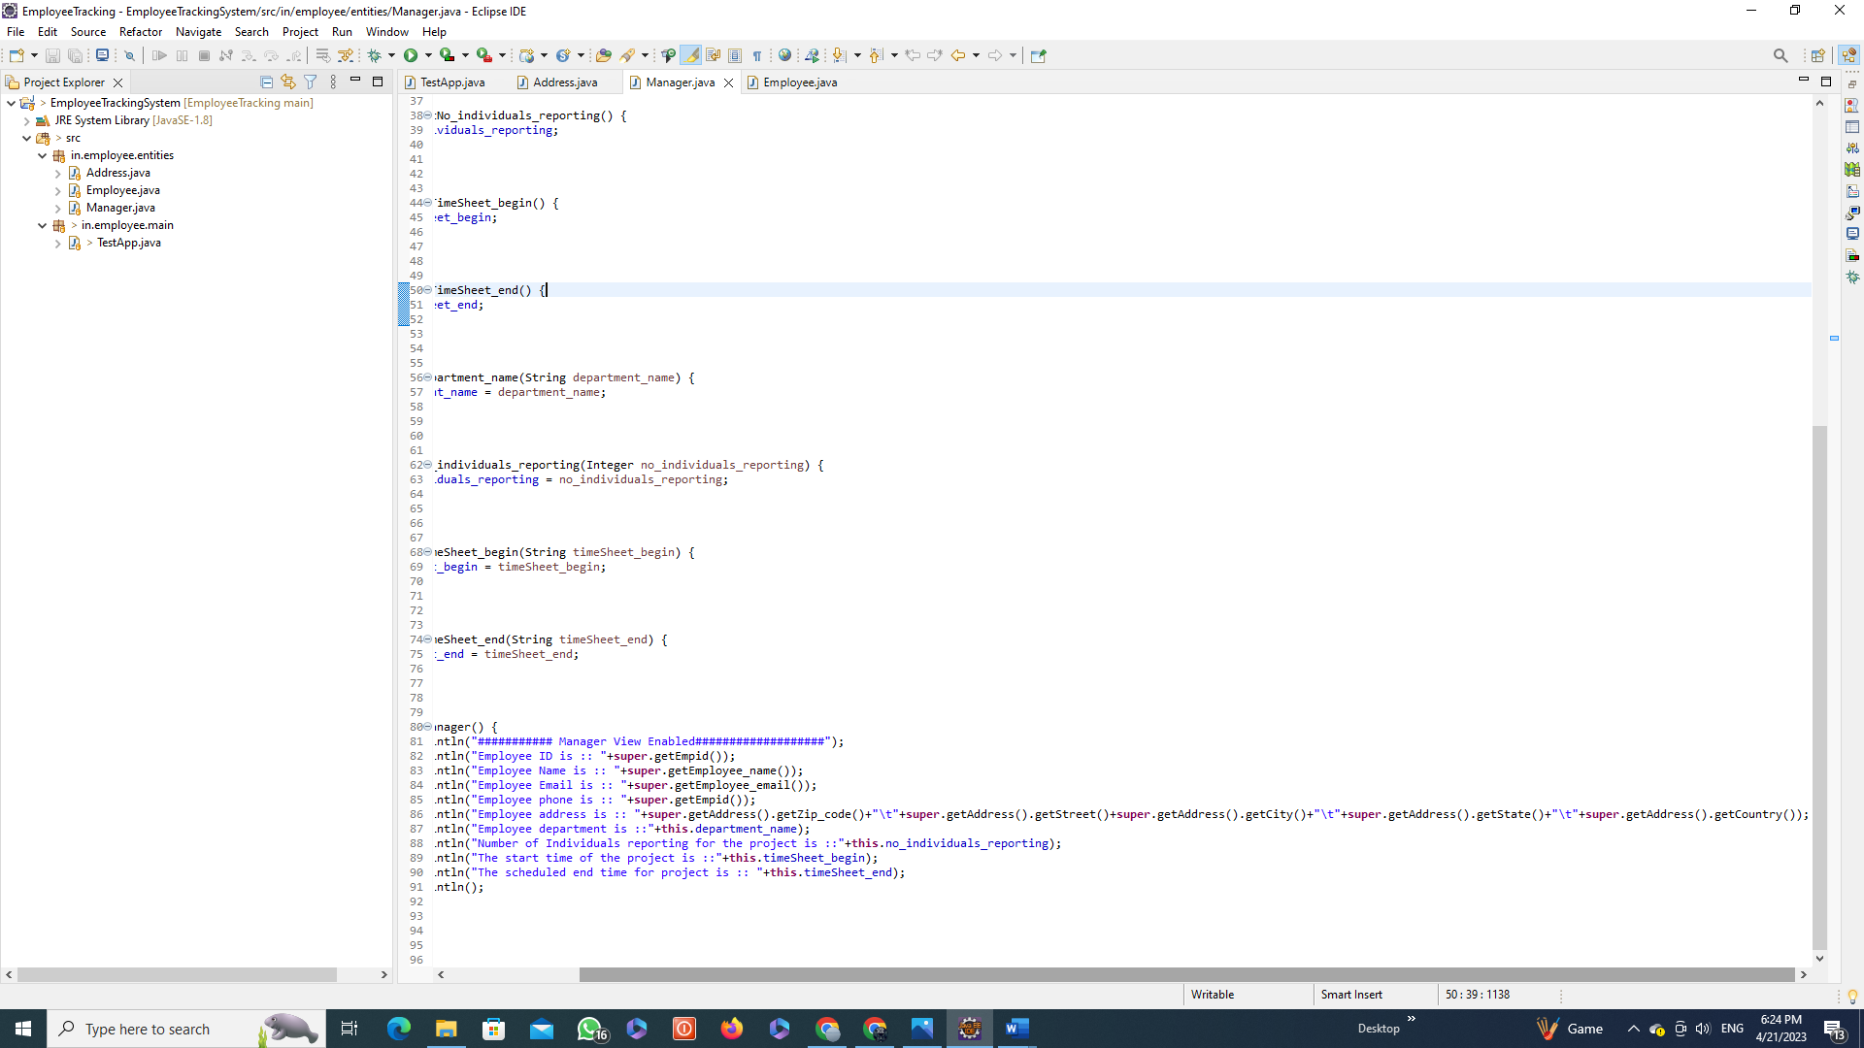

Slide 33
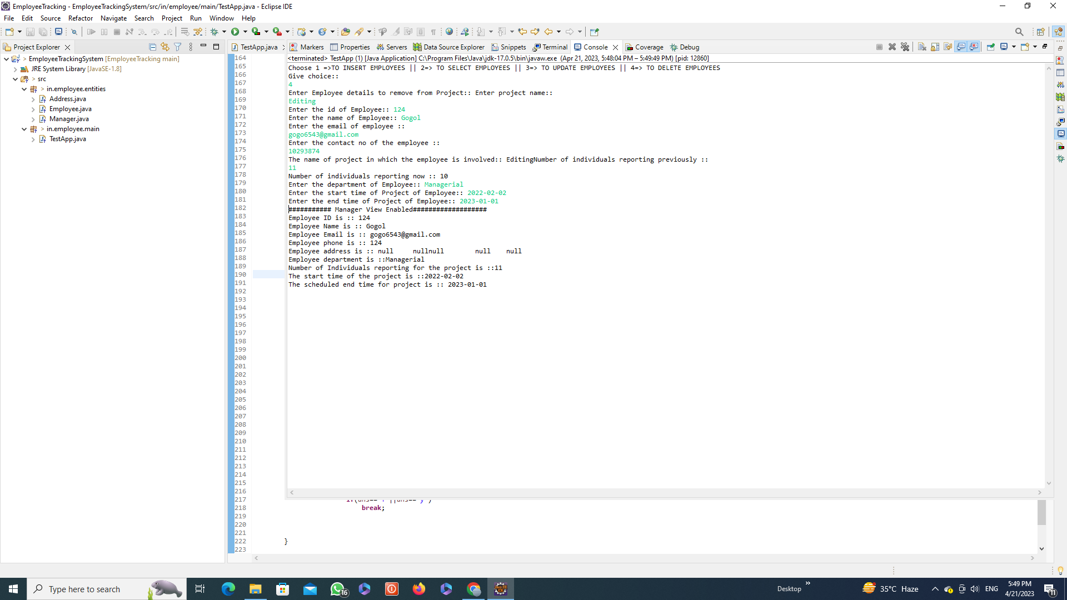

Slide 34
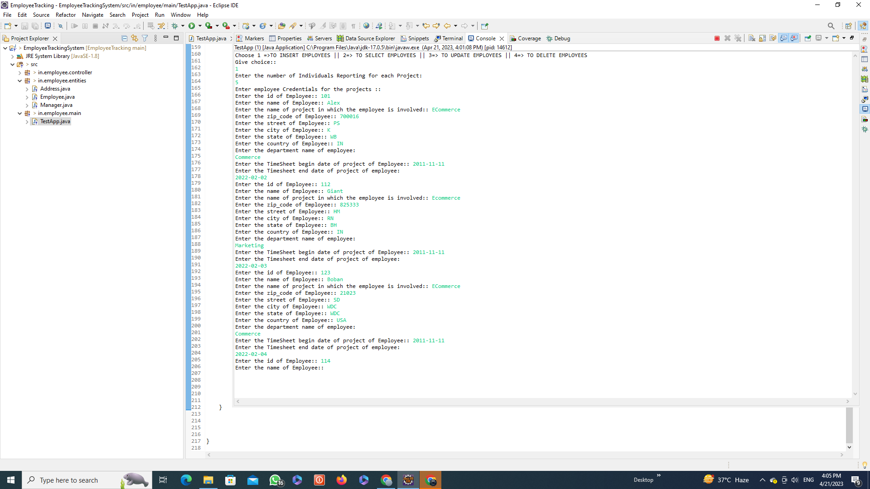

Slide 35
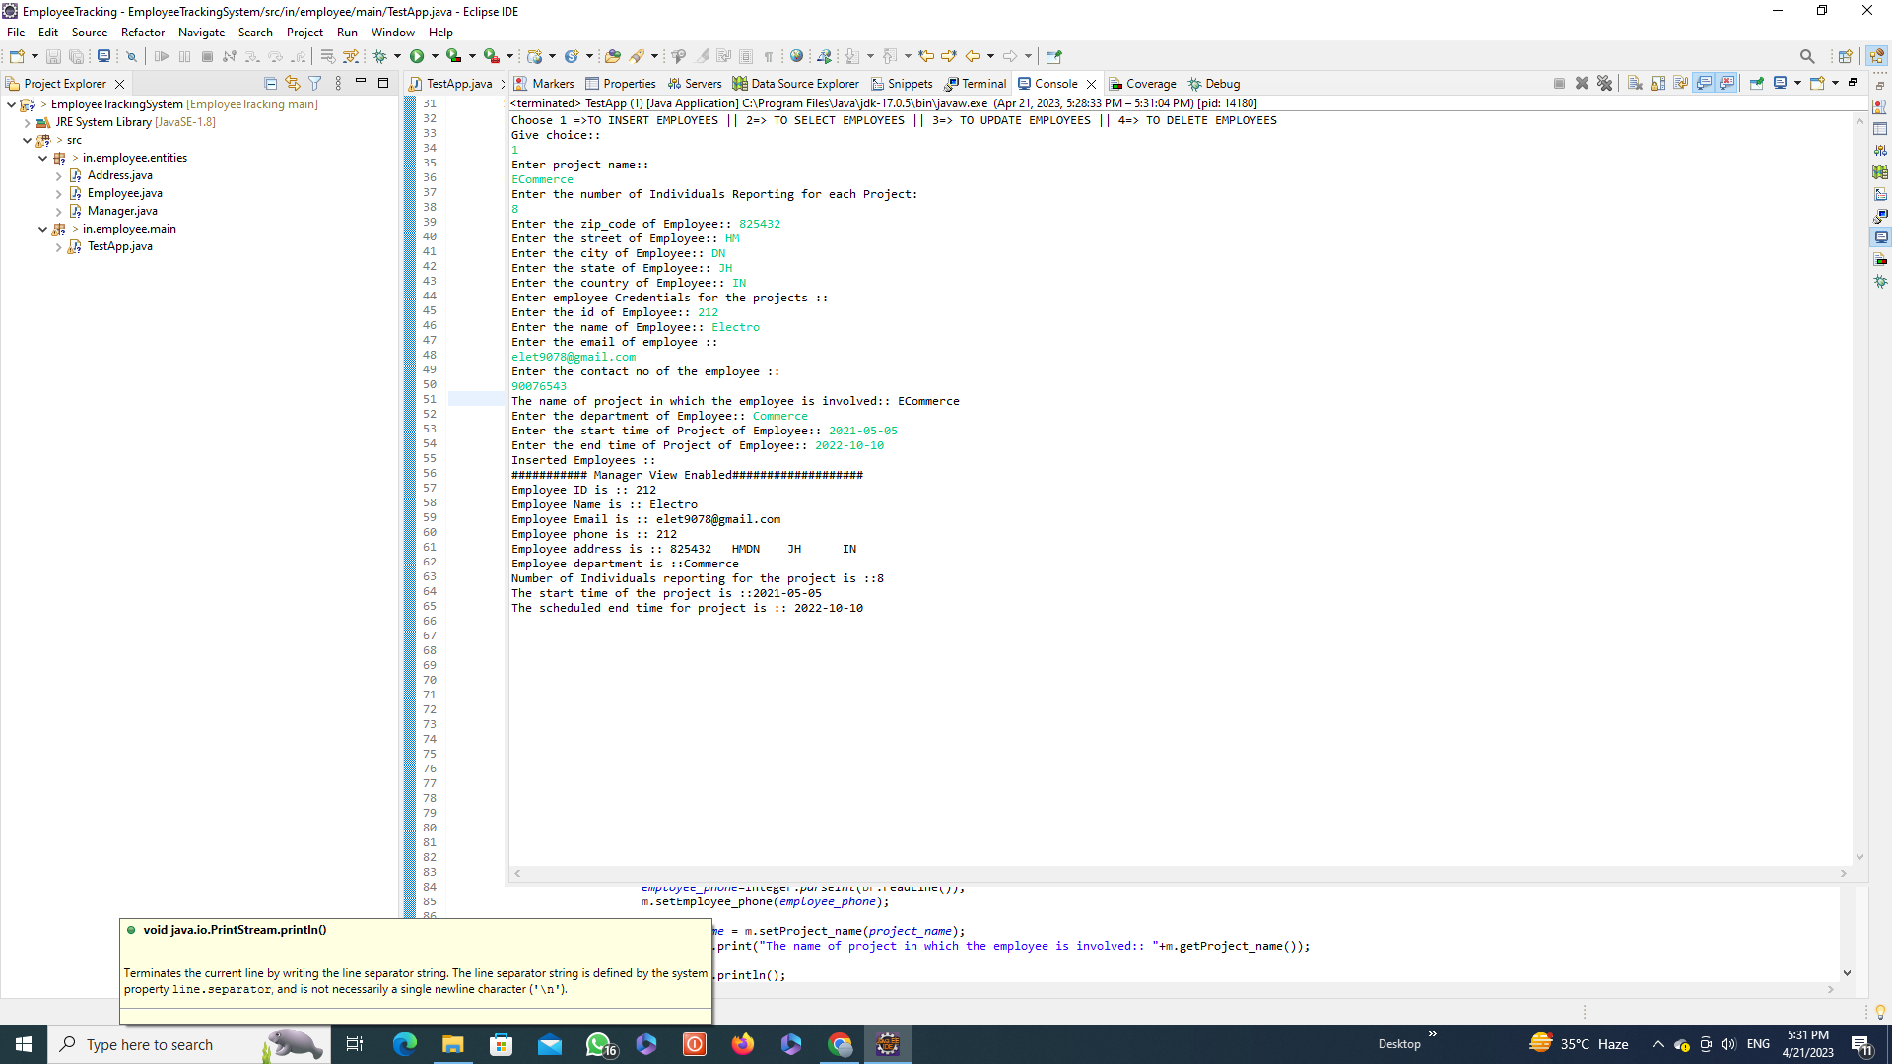

Slide 36
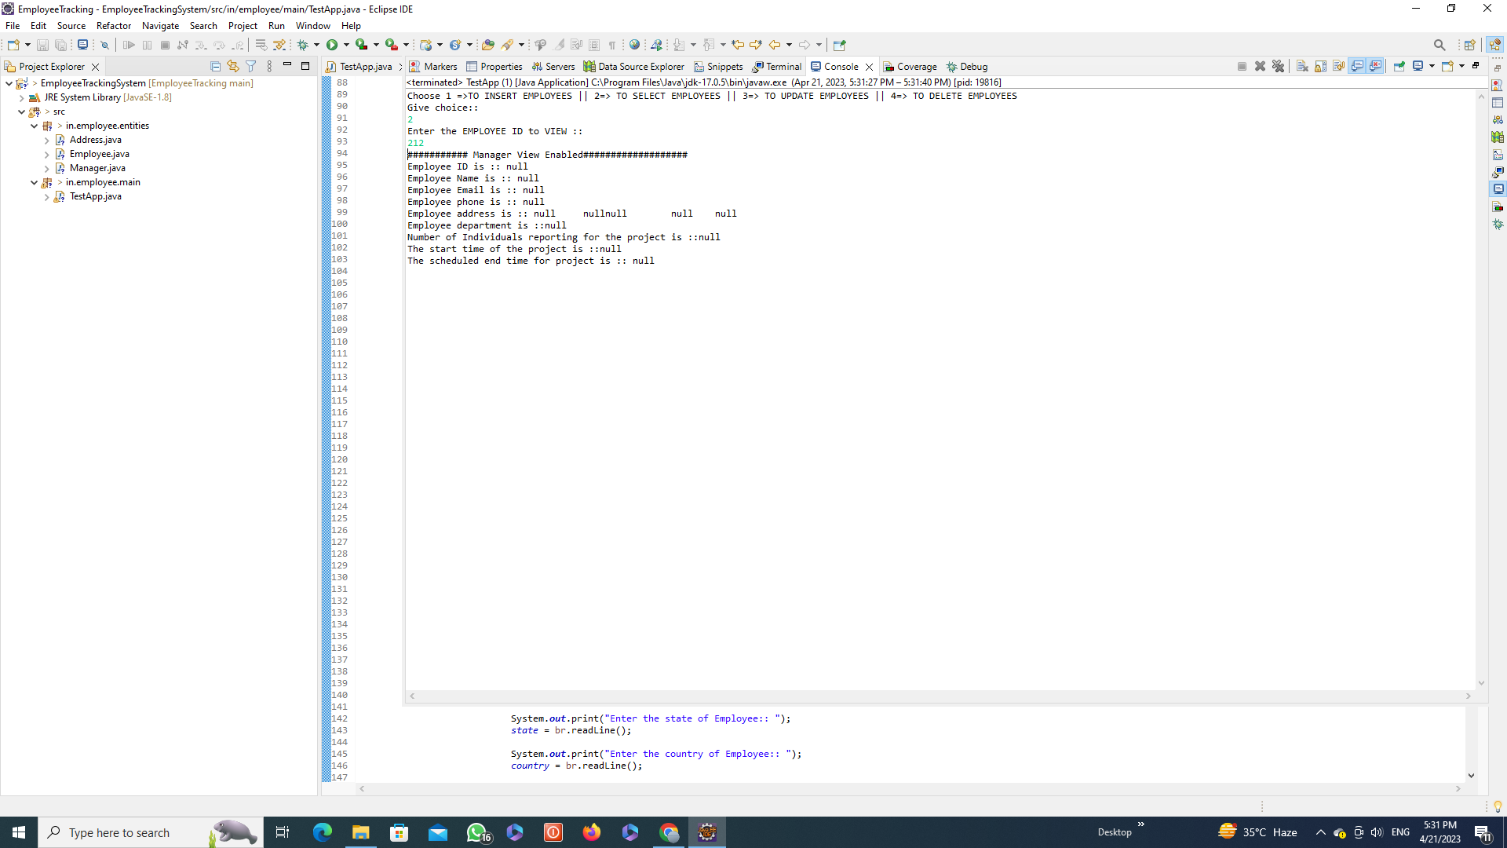

Slide 37
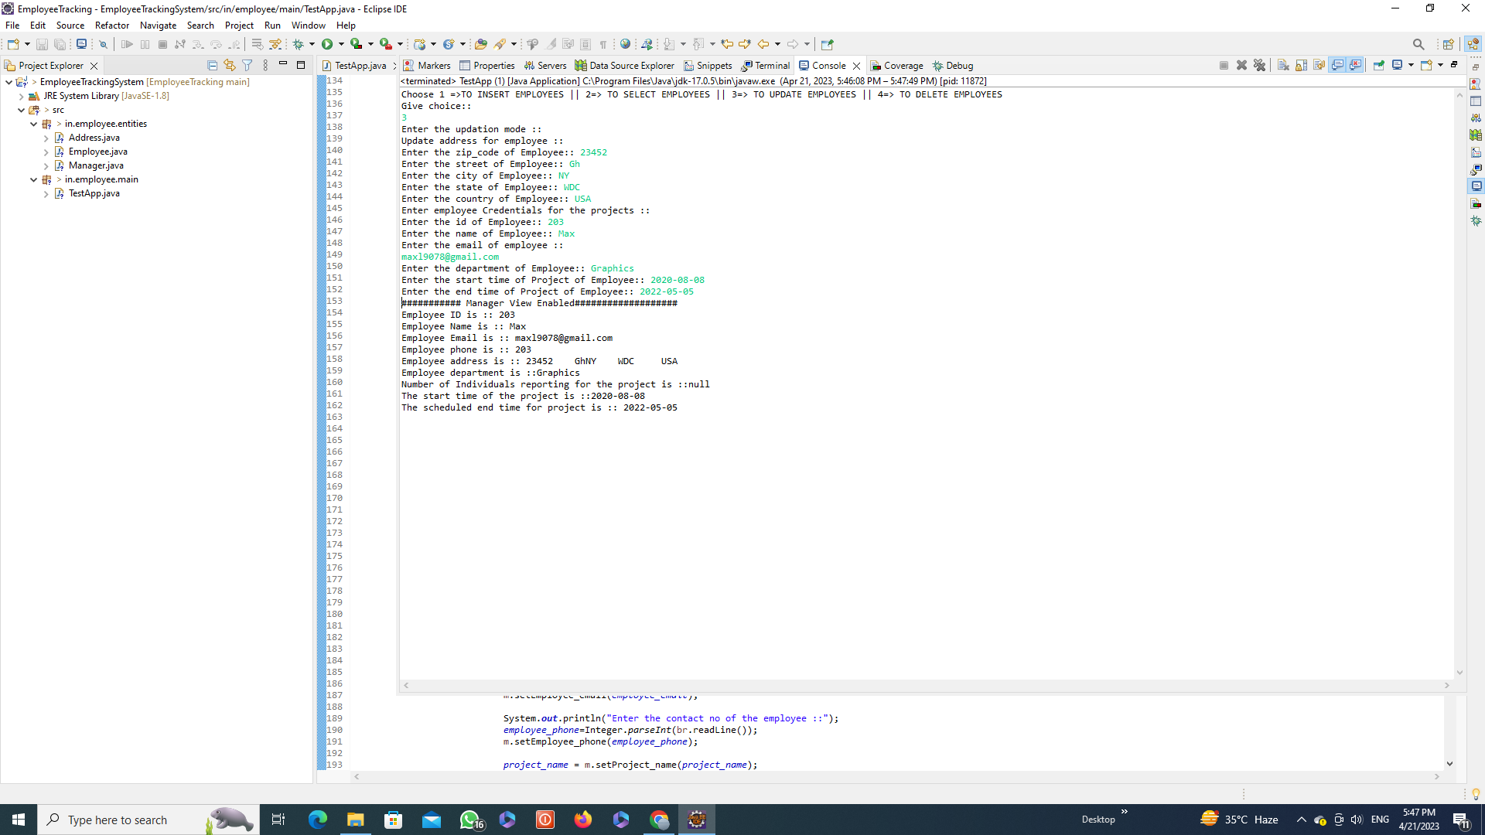

Slide 39
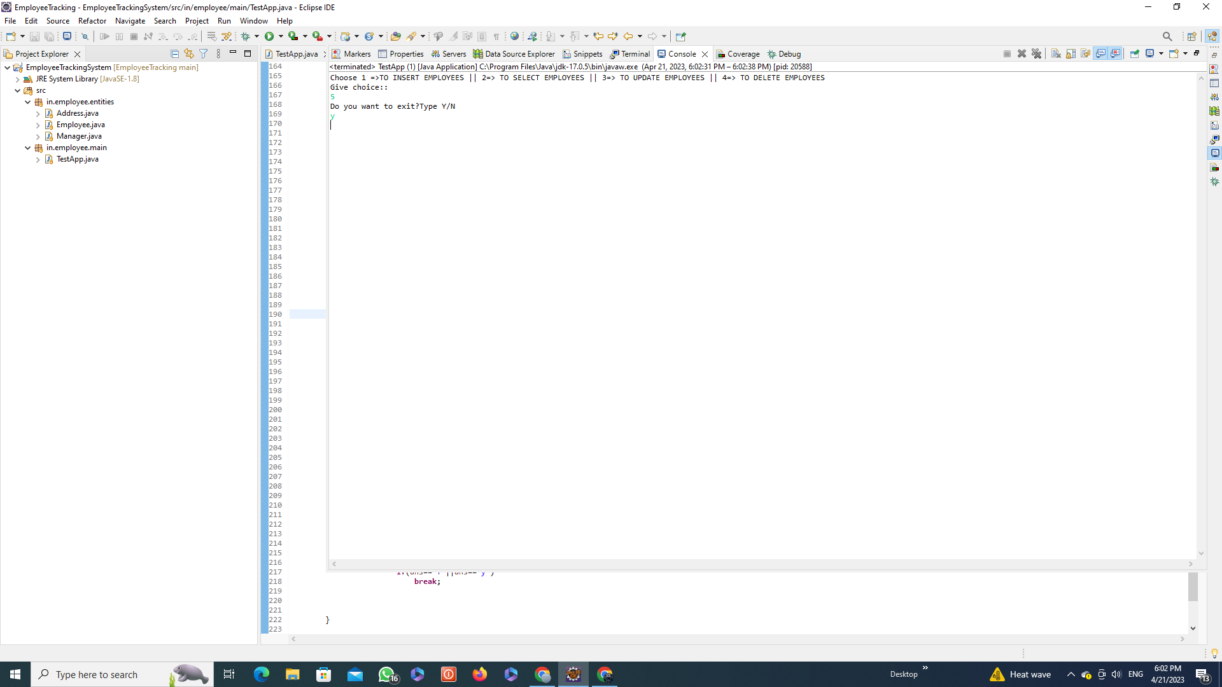

Slide 40
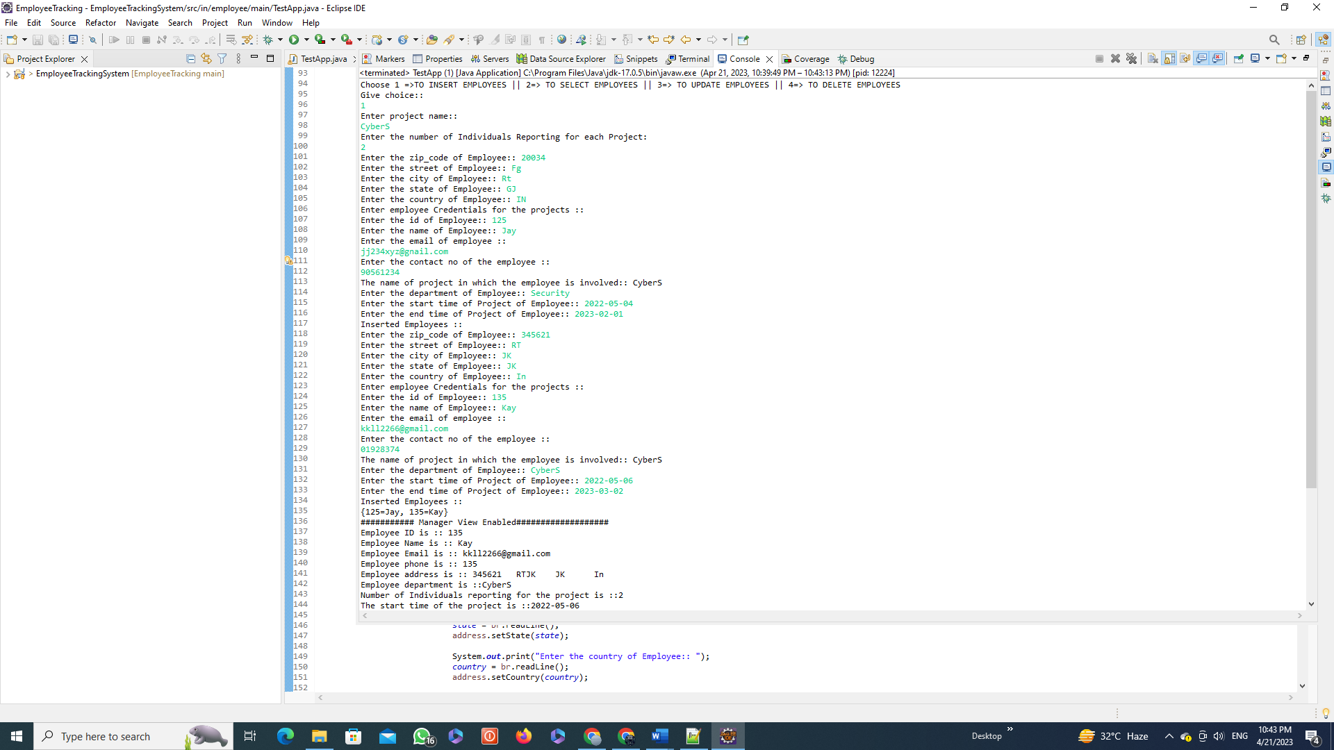

Slide 41
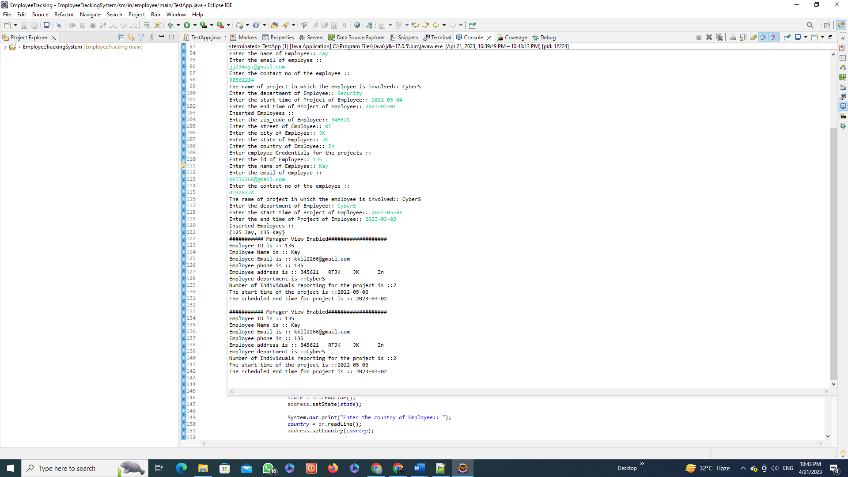

Slide 42
FUTURE SCOPE:
Hibernate integration
Database connectivity
Connecting jars in build path of project
PROJECT AVAILABLTITY:
Project-code url in github repository:
https://github.com/paramita22/EmployeeTrackingSystem/tree/main/EmployeeTrackingSystem
Project post in Linked in:
https://www.linkedin.com/feed/update/urn:li:activity:7055241634241785856/
Project demo video posted in linkedin:
https://www.linkedin.com/feed/update/urn:li:activity:7055237843085885440/

